Slide 1





Findings from the Technology Industry
Adigun Tobi
October 13, 2024

Slide 2


OUTLINE
Executive Summary
Introduction
Methodology
Results
Visualization – Charts
Dashboard
Discussion
Findings & Implications
Conclusion
Appendix

Slide 3

EXECUTIVE SUMMARY
Dominance of Web and Cloud Technologies – This reflects the current core of modern software development, which is essential for understanding the present tech landscape.
Growing Popularity of Emerging Languages – It’s important to address the shift toward Kotlin, Go, and TypeScript, as these represent future trends and demand in the industry.
Demographic Imbalance – Highlighting the significant gender gap and younger workforce can drive discussions on diversity and inclusion, which is a growing concern for many organizations.

Slide 4

INTRODUCTION
Technology is an ever-changing space and developers who have updated skillsets stay ahead of the curve
This report explores:
Current Demands in Technology highlighting the dominant technologies in use today
Future Technology Trends highlighting emerging technologies by tracking survey responses from the tech space
Demographic trends in Technology
Demand for employees by cities

Slide 5

METHODOLOGY
Data was obtained from different platforms such as Kaggle and StackOverflow
The data was gathered using WebScraping and API requests
The data was wrangled by Python and saved in both CSV and XLXS formats
Visualisation and dashboarding was done using Excel, Python, IBM Watson Studio and Google Looker

Slide 6
RESULTS
Programing Language Trends
Database Trends

Slide 7
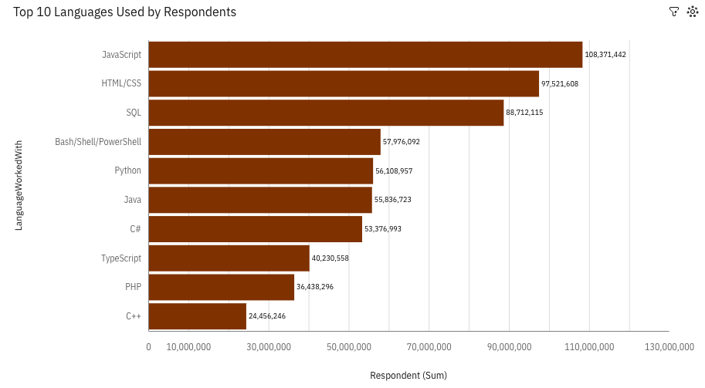
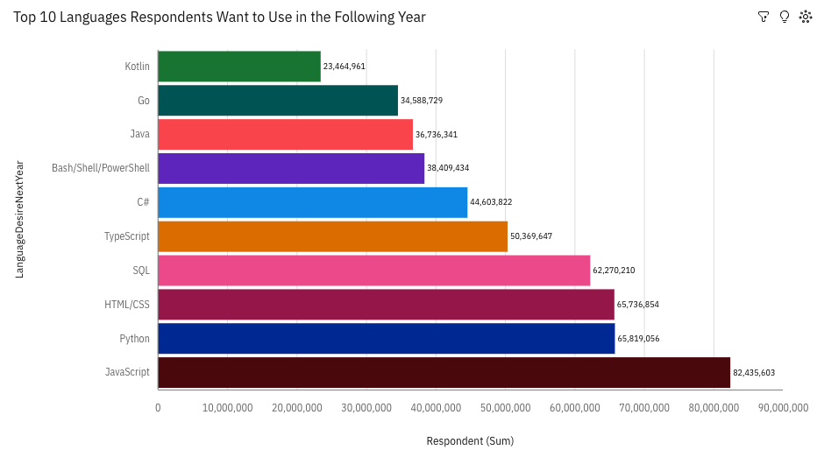
PROGRAMMING LANGUAGE TRENDS
Current Year
Next Year

Slide 8
PROGRAMMING LANGUAGE TRENDS - FINDINGS & IMPLICATIONS
Findings
Persisting interest in Javascript
Declining interest in C++
Rising interest in Python
Implications
Javascript is currently to most utilized language. Hence, programmers should use it more
Despite C++ current popularity, interest in using it signals programmers should focus on other languages
A rising demand from the employment market of Python developers.

Slide 9
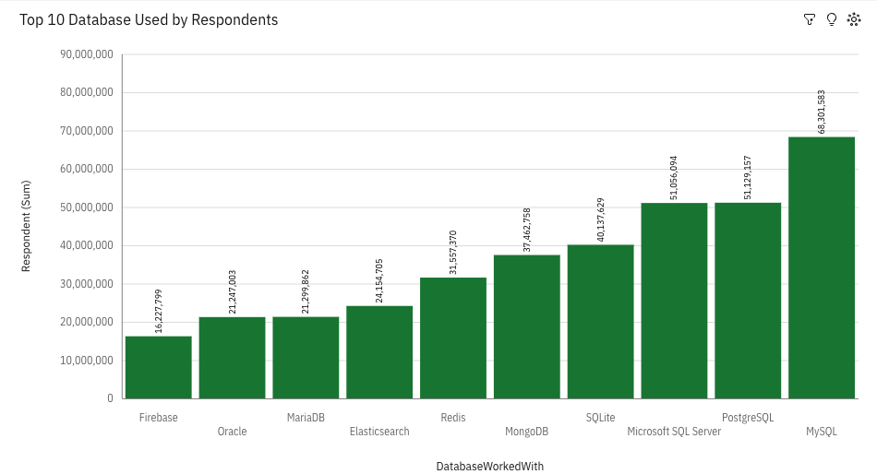
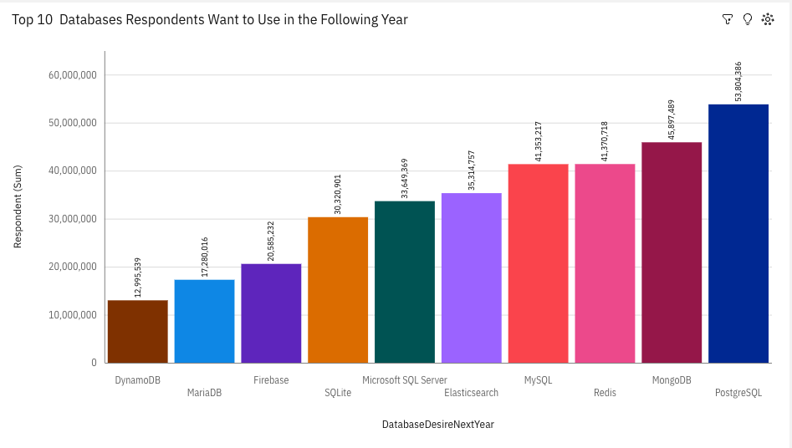
DATABASE TRENDS
Current Year
Next Year

Slide 10
DATABASE TRENDS - FINDINGS & IMPLICATIONS
Findings
Rising interest in PostgresSQL.
Declining interest in MicrosoftSQL Server.
Interest in databases such as DynamoDB.
Implications
Developers should learn this as it is the most desired database to be used by respondents.
MicrosoftSQL Server is becoming less popular among employers.
Using less popular databases could provide a niche edge for developers.

Slide 11

DASHBOARDS
Current Trends in Technology
Future Trends in Technology
Demographics in Tech
Source: https://github.com/atarod0/IBMCapstoneProject/tree/main/Dashboard

Slide 12
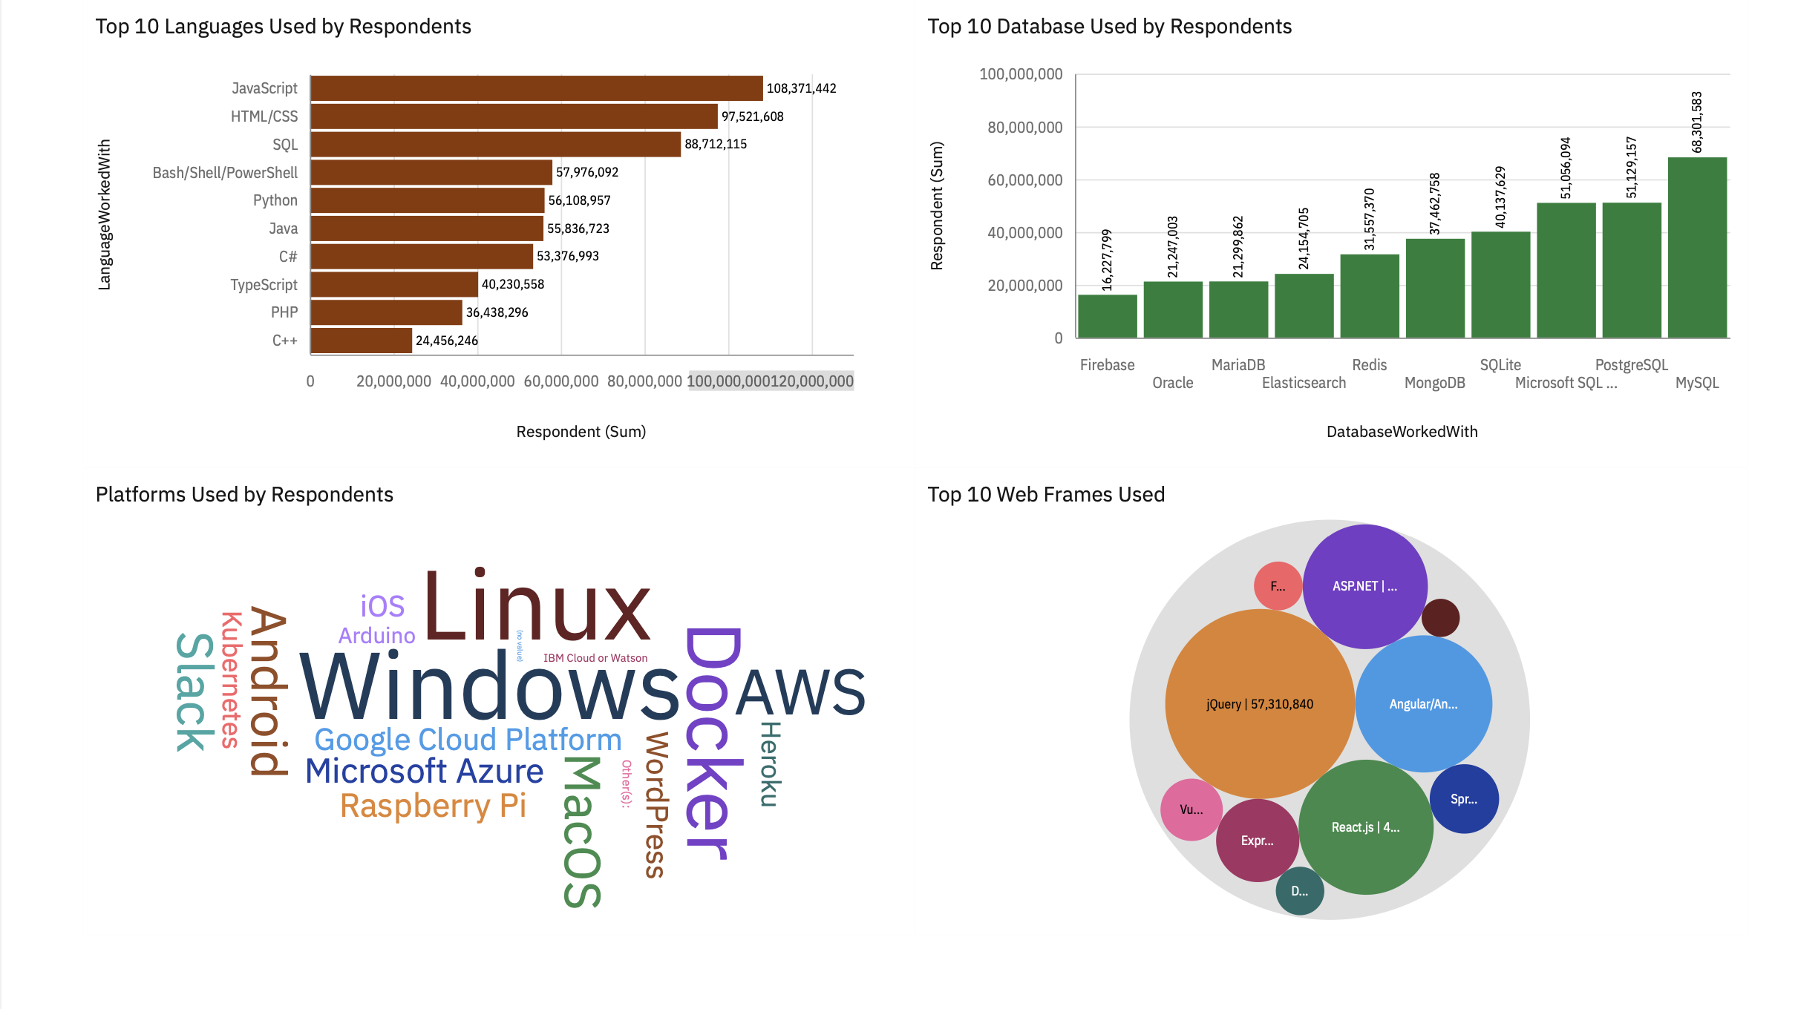
CURRENT TECHNOLOGY DASHBOARD

Slide 13
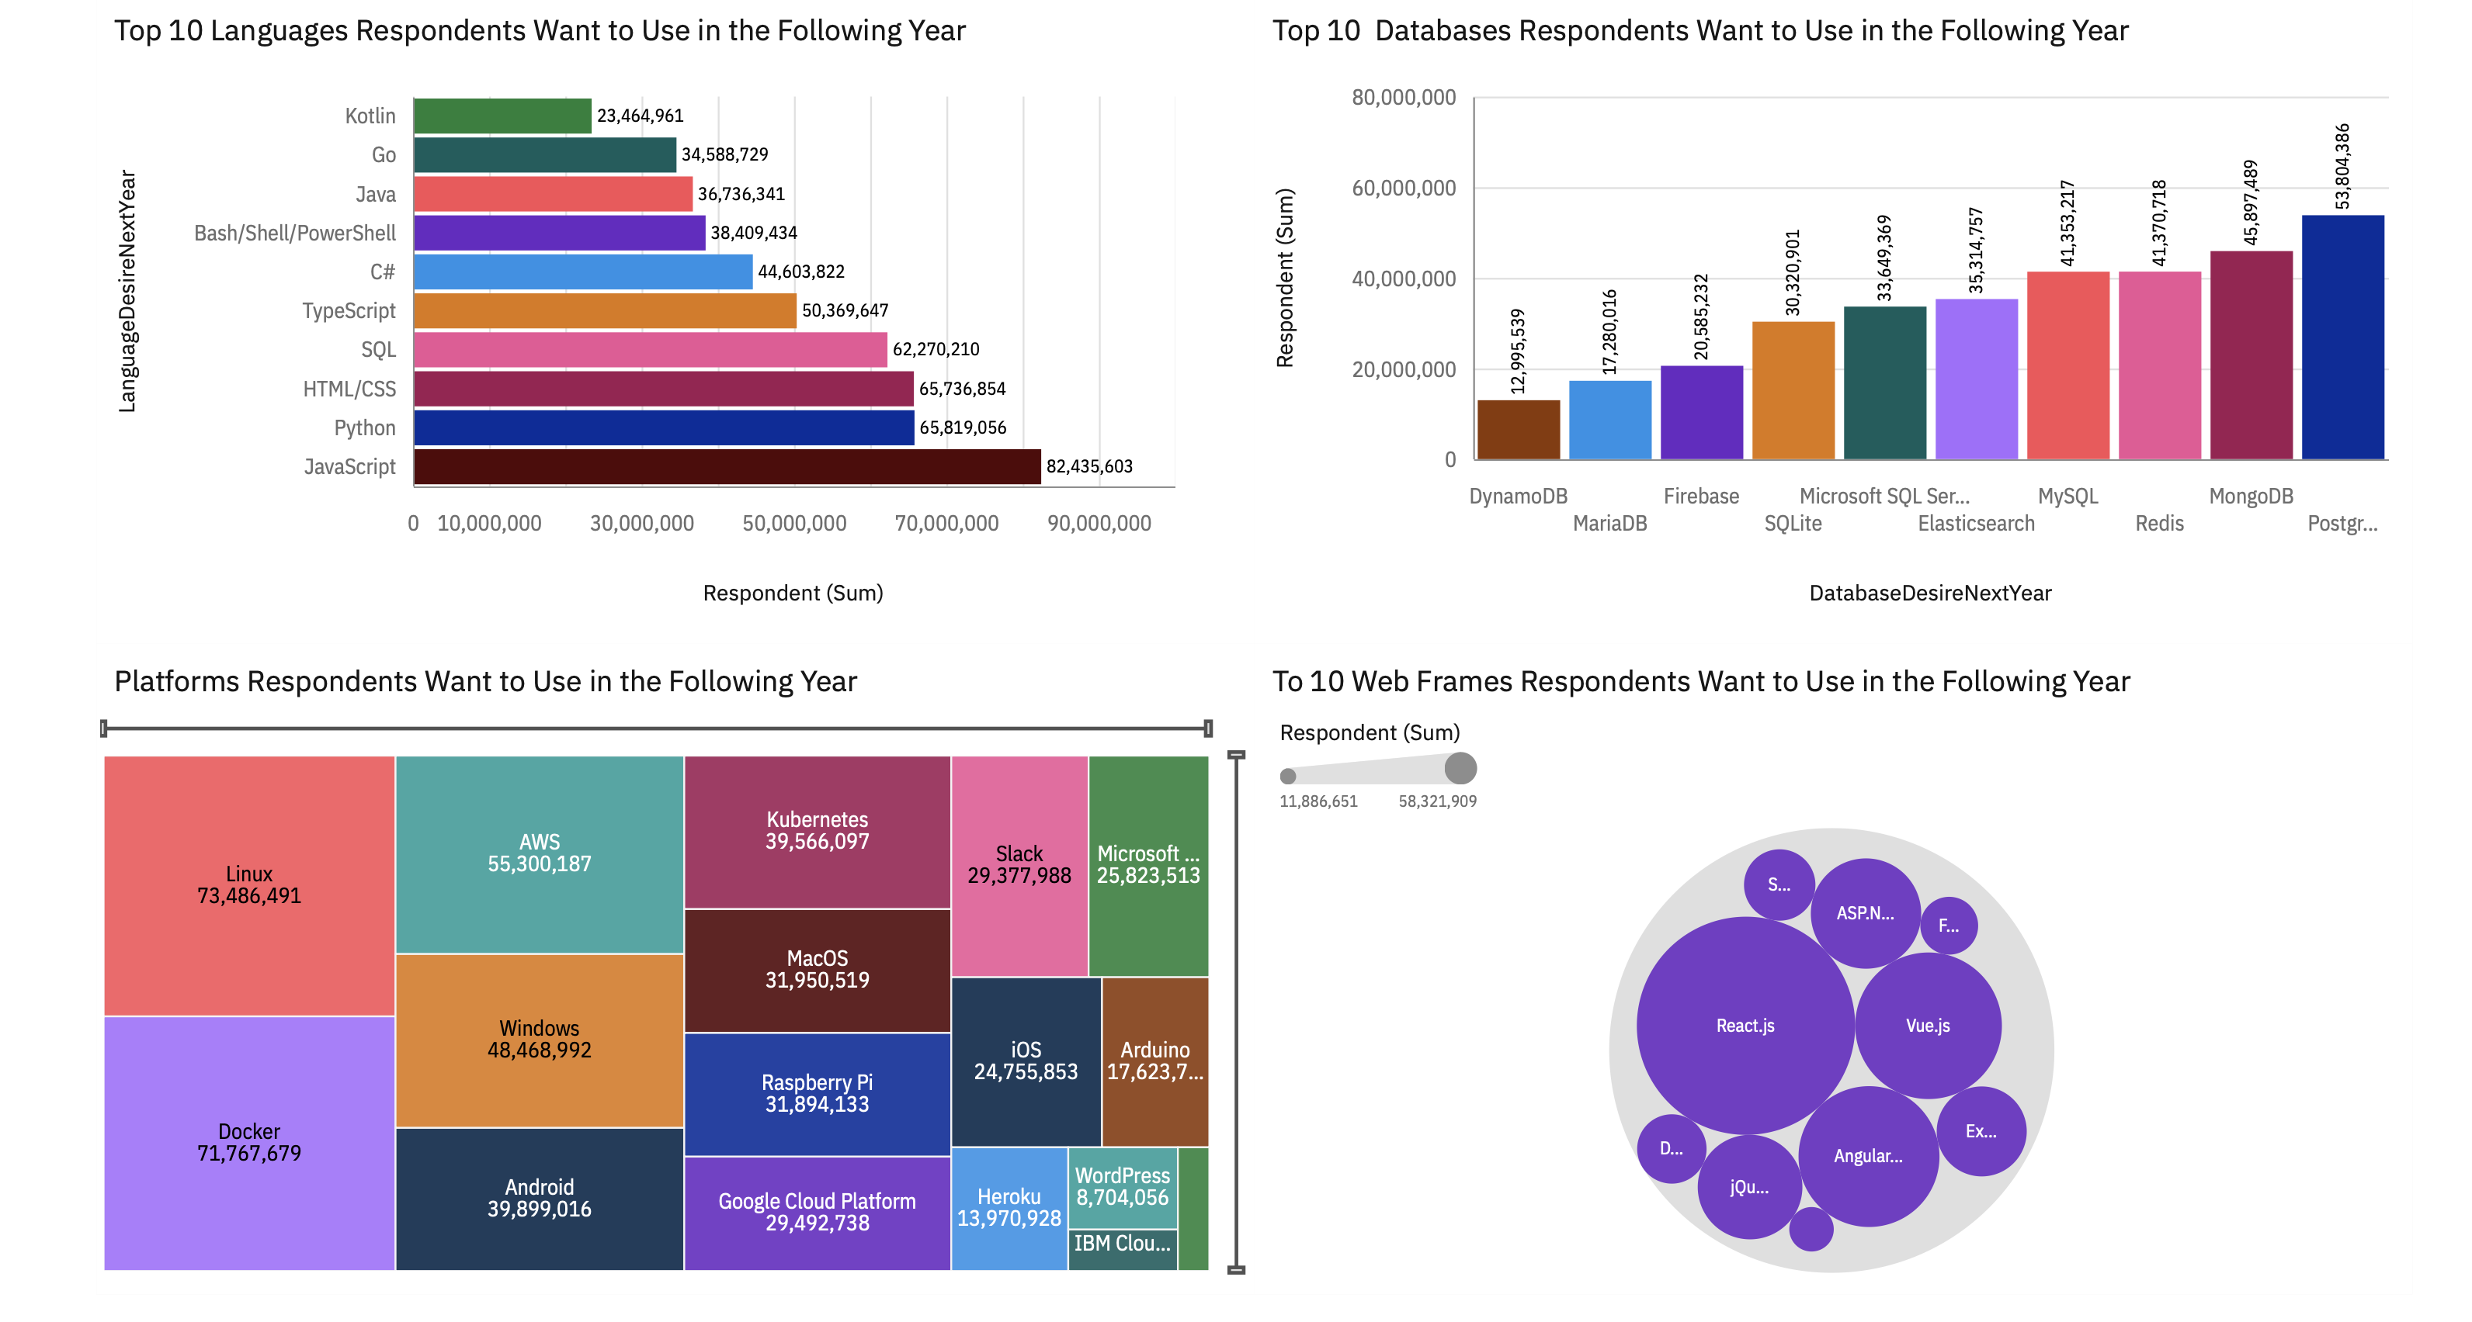
FUTURE TECHNOLOGY DASHBOARD

Slide 14
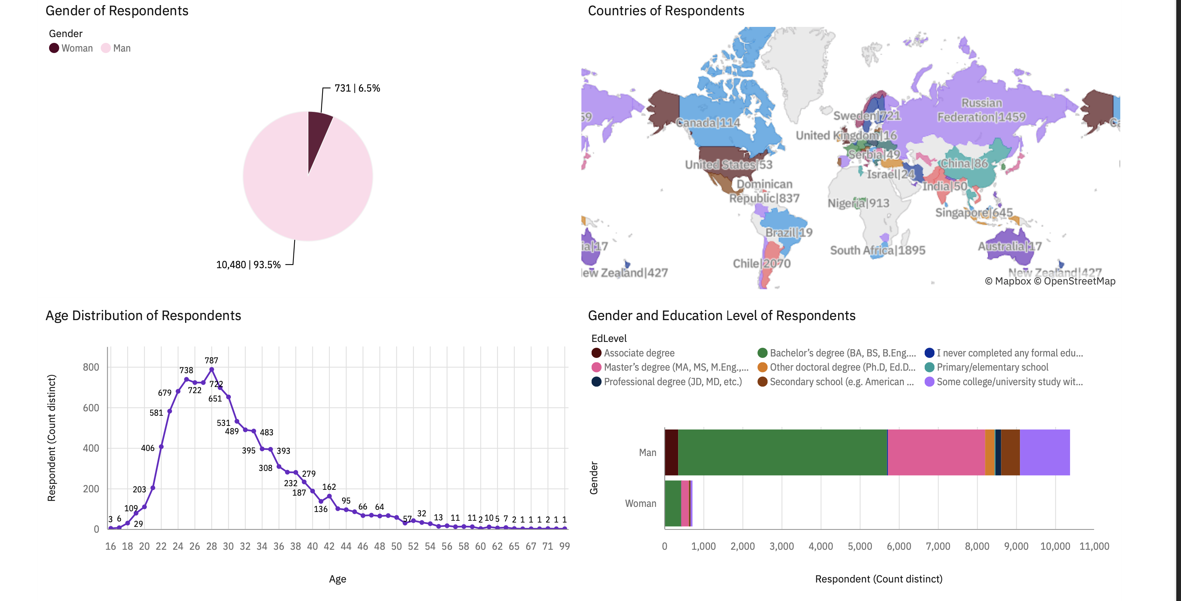
DEMOGRAPHICS DASHBOARD

Slide 15
DISCUSSION
What are the current trends in tech?
Future Trends in Tech?
What are the demographics like?

Slide 16
OVERALL FINDINGS & IMPLICATIONS
Findings
JavaScript, HTML/CSS and SQL dominate the programming languages landscape.
Rising interest in Kotlin, Go, and TypeScript for future projects
Gender disparity in the tech space despite young workforce
Implications
Web development is currently popular as these are core tools for it.
Demanded skills switching to mobile development as Kotlin and Go are for mobile development
Limitation of innovation through different perspectives

Slide 17

CONCLUSION
Web Development and Cloud Domination: JavaScript, HTML/CSS, and SQL are extensively used, indicating web development's stronghold, while platforms like AWS, Linux, and Docker suggest the growing prominence of cloud computing and containerization in modern tech stacks.
Emerging Tech Skills and Database Preferences: Kotlin, Go, and TypeScript are gaining traction, signalling the need for up-skilling in mobile and systems development. Open-source databases like MySQL and PostgreSQL are top choices, highlighting their scalability and flexibility.
Demographic Imbalance and Opportunities: The significant gender gap (93.5% men) and younger workforce (25-30 age peak) in tech underline the need for more diversity and inclusion efforts, offering potential for innovation through varied perspectives.

Slide 18
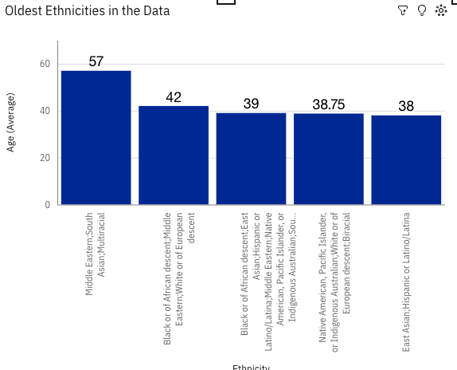

APPENDIX

Slide 19
JOB POSTINGS
High supply of jobs in Washington DC, Detroit and Seattle
Declining supply of jobs in typical tech hubs Los Angeles and San Francisco

Slide 20
POPULAR LANGUAGES
The data shows that traditional, well-established technologies like C, Java, and Oracle still have high demand.
Emerging technologies like Python and MongoDB are gaining traction.
Demand for more niche technologies like Scala and PostgreSQL is relatively low, suggesting they are more specialized.

